Slide 1

Week 12
Polymorphism and Virtual Function
Source from Tony Gaddis, Starting out with C++, 7th edition update. 2014. Pearson
edited by Dr. Dayang Norhayati Abang Jawawi (Prof. Madya ), UTM dayang@utm.my

Slide 2
Week 12
Polymorphism

Slide 3
Problem with Subclasses
Consider the existence of a draw function for each subclass
Shape
Shape class hierarchy
Circle
Triangle
Rectangle
Right Triangle
Isosceles Triangle
Square

Slide 4
Introduction
Circle c;
Square s;
Shape *cs = &c;
:
cs=&s;
Consider a pointer of the base class (which can also point to various objects of the derived classes)
How do you specify which draw statement to be called when using the reference

Slide 5
Introduction
Polymorphism
Enables “programming in the general”
The same invocation can produce “many forms” of results
Programmers can command objects to behave in manners appropriate to those objects,
without knowing the types of the objects
(as long as the objects belong to the same inheritance hierarchy).

Slide 6
Polymorphism
When a program invokes a method through a base class variable,
the correct derived class version of the method is called,
based on the type of the reference stored in the base class variable
The same method name and signature can cause different actions to occur,
depending on the type of object on which the method is invoked

Slide 7
Exercise - Lab 9 01
Refer to Lab 9
Exercise 1
Question 1
Page 202
Solve the problem.

Slide 8
15.6
Polymorphism & Virtual Functions

Slide 9
Polymorphism and Virtual Member Functions
Polymorphism
Associating many meanings to one function
Virtual functions provide this capability
Fundamental principle of object-oriented programming!
Virtual
Existing in "essence" though not in fact
Virtual Function
Can be "used" before it’s "defined"

Slide 10
Polymorphism and Virtual Member Functions
Virtual member function: function in base class that expects to be redefined in derived class
Function defined with key word virtual:
virtual void Y() {...}
Supports dynamic binding: functions bound at run time to function that they call
Without virtual member functions, C++ uses static (compile time) binding

Slide 11
Virtual Functions
class A {
public:
void x() {cout<<"A::x";};
virtual void y() {cout<<"A::y";};
};
class B : public A {
public:
void x() {cout<<"B::x";};
virtual void y() {cout<<"B::y";};
};
int main () {
B b;
A *ap = &b; B *bp = &b;
b.x (); // prints "B::x"
b.y (); // prints "B::y"
bp->x (); // prints "B::x"
bp->y (); // prints "B::y"
ap->x (); // prints "A::x"
ap->y (); // prints "B::y"
return 0;
};
Only matter with pointer or reference
Calls on object itself resolved statically
E.g., b.y();
Look first at pointer/reference type
If non-virtual there, resolve statically
E.g., ap->x();
If virtual there, resolve dynamically
E.g., ap->y();
Note that virtual keyword need not be repeated in derived classes
But it’s good style to do so
Caller can force static resolution of a virtual function via scope operator
E.g., ap->A::y(); prints “A::y”

Slide 12
Static Binding
The x() function is statically bound (at compile time) with the A class's version of the function.
We can remedy this by making the function virtual.

Slide 13
Virtual Functions
A virtual function is dynamically bound to calls at runtime.
At runtime, C++ determines the type of object making the call, and binds the function to the appropriate version of the function.

Slide 14
Virtual Functions
To make a function virtual, place the virtual key word before the return type in the base class's declaration: virtual char getLetterGrade() const;
The compiler will not bind the function to calls. Instead, the program will bind them at runtime.

Slide 15
Exercise - Lab 9 02
Refer to Lab 9
Exercise 1
Question 2
Page 203
Solve the problem.

Slide 16
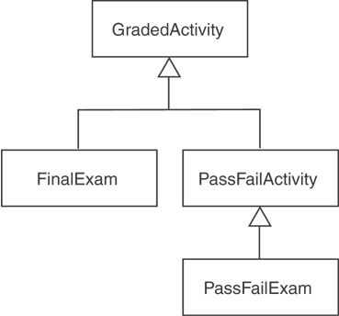
Polymorphism Requires References or Pointers
Polymorphic behavior is only possible when an object is referenced by a reference variable or a pointer, as demonstrated in :
Function parameter pointer Program15-13
Base class pointer 15-14

Slide 17
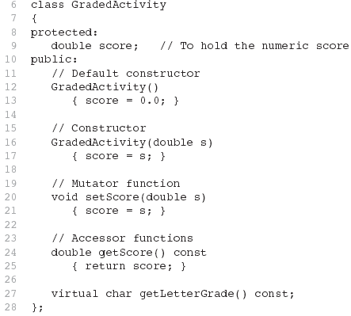
Function Parameter Pointers
The function is now virtual.
The function also becomes virtual in all derived classes automatically!

Slide 18
Function Parameter Pointers
// Function prototype
void displayGrade(const GradedActivity *);
int main()
{
GradedActivity test1(88.0);
PassFailExam test2(100, 25, 70.0);
cout << "Test 1:\n";
displayGrade(&test1);
cout << "\nTest 2:\n";
displayGrade(&test2);
return 0;
}
void displayGrade(const GradedActivity *activity)
{
cout << setprecision(1) << fixed;
cout << "The activity's numeric score is "
<< activity->getScore() << endl;
cout << "The activity's letter grade is "
<< activity->getLetterGrade() << endl;
}

Slide 19

Base Class Pointers
Can define a pointer to a base class object
Can assign it the address of a derived class object

Slide 20
Base Class Pointers
Base class pointers and references only know about members of the base class
So, you can’t use a base class pointer to call a derived class function
Redefined functions in derived class will be ignored unless base class declares the function virtual

Slide 21
Redefining vs. Overriding
In C++, redefined functions are statically bound and overridden functions are dynamically bound.
So, a virtual function is overridden, and a non-virtual function is redefined.

Slide 22
Exercise - Lab 9 03
Refer to Lab 9
Exercise 2
Question 3
Page 210
Solve the problem.
Write the main() function to test your classes with an object is referenced by a reference variable.
Example : B *b = new B; D *d = new D; and
B *bd = new D;
Set values and call function calc().

Slide 23
Virtual Destructors
It's a good idea to make destructors virtual if the class could ever become a base class.
Otherwise, the compiler will perform static binding on the destructor if the class ever is derived from.

Slide 24
Virtual Destructors
Recall: destructors needed to de-allocate dynamically allocated data
Consider: Base *pBase = new Derived; … delete pBase;
Would call base class destructor even though pointing to Derived class object!
Making destructor virtual fixes this!
Good policy for all destructors to be virtual

Slide 25
Virtual Destructors
class A {
public:
A () {cout<<" A";}
virtual ~A () {cout<<" ~A";}
};
class B : public A {
public:
B () :A() {cout<<" B";}
virtual ~B() {cout<<" ~B";}
};
int main (int, char *[]) {
// prints "A B"
A *ap = new B;
// prints "~B ~A" : would only
// print "~A" if non-virtual
delete ap;
return 0;
};
Virtual Destructor

Slide 26
15.7
Abstract Base Classes and Pure Virtual Functions

Slide 27
Abstract Base Classes and Pure Virtual Functions
Pure virtual function: a virtual member function that must be overridden in a derived class that has objects
Abstract base class contains at least one pure virtual function:
virtual void Y() = 0;
The = 0 indicates a pure virtual function
Must have no function definition in the base class

Slide 28
Abstract Base Classes and Pure Virtual Functions
Abstract base class: class that can have no objects. Serves as a basis for derived classes that may/will have objects
A class becomes an abstract base class when one or more of its member functions is a pure virtual function

Slide 29
Pure Virtual Functions
A is an abstract (base) class
Similar to an interface in Java
Declares pure virtual functions (=0)
May also have non-virtual methods, as well as virtual methods that are not pure virtual
Derived classes override pure virtual methods
B overrides x(), C overrides y()
Can’t instantiate an abstract class
class that declares pure virtual functions
or inherits ones that are not overridden
A and B are abstract, can create a C
Can still have a pointer or reference to an abstract class type
Useful for polymorphism
class A {
public:
virtual void x() = 0;
virtual void y() = 0;
};
class B : public A {
public:
virtual void x();
};
class C : public B {
public:
virtual void y();
};
int main () {
A * ap = new C;
ap->x ();
ap->y ();
delete ap;
return 0;
};

Slide 30
Design with Pure Virtual Functions
Animal
move()=0
Pure virtual functions let us specify interfaces appropriately
But let us defer implementation decisions until later (subclasses)
As the type hierarchy is extended, pure virtual functions are replaced
By virtual functions that fill in (and may override) the implementation details
Key idea: refinement
Fish
Mammal
move()
move()
swim()
walk()
Bird
Sparrow
Penguin
move()
move()
walk()
waddle()
fly()
swim()

Slide 31
Exercise - Lab 9 04
Refer to Lab 9
Exercise 1
Question 3 & 4
Page 205
Solve the problem.

Slide 32
15.8
Multiple Inheritance

Slide 33
Multiple Inheritance
A derived class can have more than one base class
Each base class can have its own access specification in derived class's definition:
class cube : public square,
public rectSolid;
class
square
class
rectSolid
class
cube

Slide 34
Multiple Inheritance
Arguments can be passed to both base classes' constructors:
cube::cube(int side) : square(side),
rectSolid(side, side, side);
Base class constructors are called in order given in class declaration, not in order used in class constructor

Slide 35
Multiple Inheritance
Problem: what if base classes have member variables/functions with the same name?
Solutions:
Derived class redefines the multiply-defined function
Derived class invokes member function in a particular base class using scope resolution operator ::
Compiler errors occur if derived class uses base class function without one of these solutions

Slide 36
Exercise - Lab 8 04
Refer to Lab 8
Exercise 2
Question 6
Page 194
Solve the problem.

Slide 37
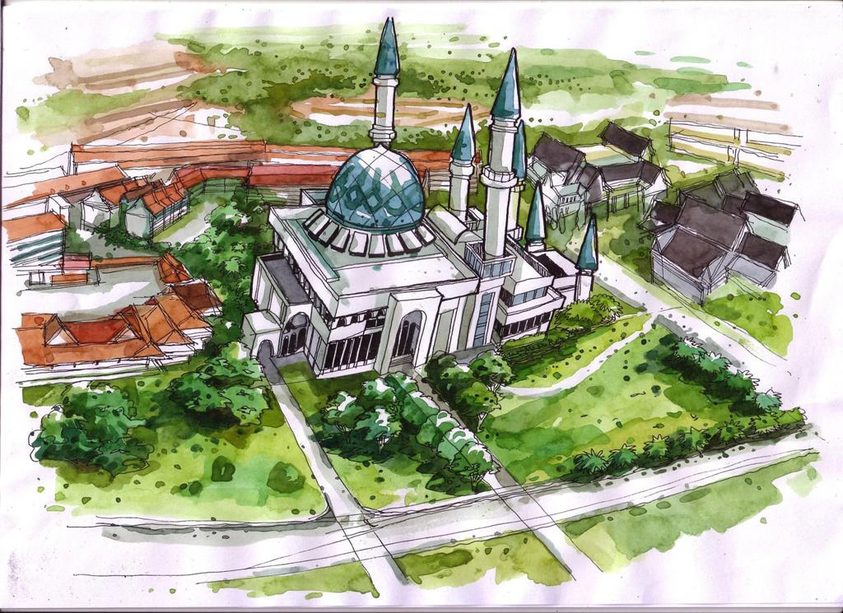
Dayang N. A. Jawawi dayang@utm.my
http://comp.utm.my/dayang/

Slide 38
Lab Exercise 06
Solve the problems given
Lab 9
Exercise 3
Question 1
Page 211 - 214
Solve the problem.
Create a table to check your solution.
Submit online elearning by Monday 01th June 2015 the program (.cpp file) and a set of table your created to check your solution.

